Slide 1
Layout and Stick Diagrams

Slide 2
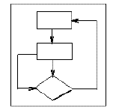
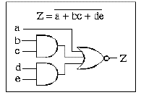
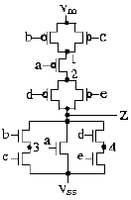
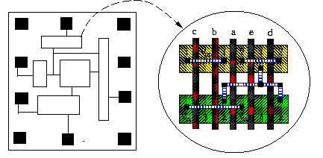
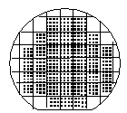

VLSI Design Flow
System Specification
functional simulation
specification
Function/architecture Design
logic simulation
behavioral representation
Logic Synthesis
circuit analysis
structural representation
Circuit Design
extraction & verification
structural representation
Physical Synthesis
physical representation
Fabrication
Packaging

Slide 3
Layout
Layout consists of creating appropriate masks that define the sizes and locations of sources, drains, gates, and the necessary interconnections
Layout is the lowest level of design abstraction for VLSI
Layout is directly sent to the manufacturer
Layout determines the circuit topology and the characteristics of components
Layout
Layout consists of creating appropriate masks that define the sizes and locations of sources, drains, gates, and the necessary interconnections
Layout is the lowest level of design abstraction for VLSI
Layout is directly sent to the manufacturer
Layout determines the circuit topology and the characteristics of components

Slide 4
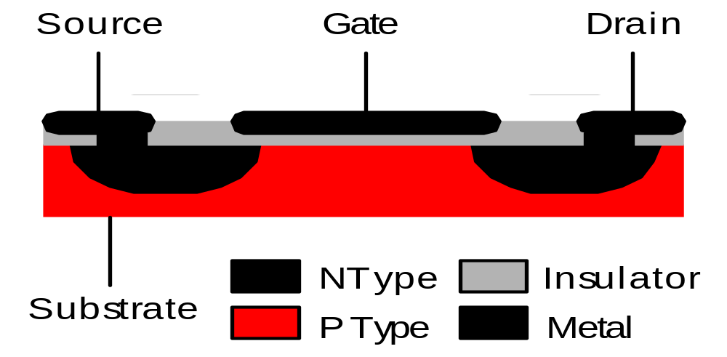
MOSFET: Metal Oxide Semiconductor Field-Effect Transistor
n channel MOSFET
In lightly doped p-type substrate, two highly doped n regions (source and drain) are diffused
Insulator is grown over surface and holes are cut into it to have contact with source and drain
For Si substrate, SiO₂ is used as the Insulator

Slide 5
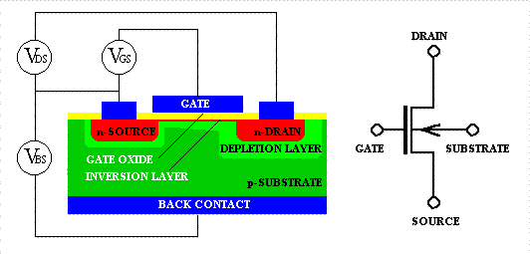
Metal-Oxide-Semiconductor Field-Effect Transistor (MOSFET)
n-channel

Slide 6
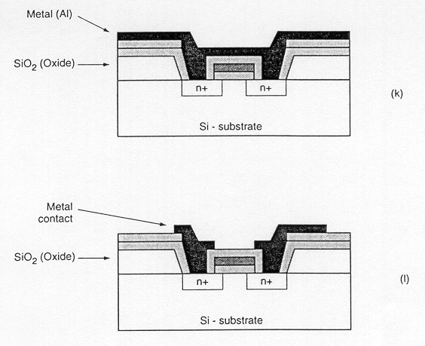
NMOS

Slide 7
MOS Metalization process
  It consists of three levels of conducting
  material (Diffused region, polysilicon, metal )
  Each layer is isolated from the
  layers immediately above and below
  Layers are color coded according to
  different photolithigraphic masks needed
Metal
Oxide
Poly
Oxide
Diffused
Bulk substrate
NMOS
Metal
Oxide
Polysilicon
Poly
Oxide
Diffused
Bulk substrate
PMOS

Slide 8
MOS Metalization process
In some processes, there may be second metal layer
In some processes, a second polysilicon layer may exist
Layers may be joined together where contacts are formed
Metal
Oxide
Poly
Oxide
Diffused
Bulk substrate
NMOS
Metal
Oxide
Polysilicon
Poly
Oxide
Diffused
Bulk substrate
PMOS

Slide 9
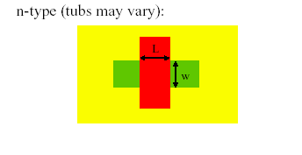
Transistor Layout

Slide 10
n-well process
Gate
NMOS
NMOS
PMOS
PMOS
FOX
p-substrate
n+
n+
n+
n+
p+
p+
p+
p+
n-well
MOSFET Layers in an n-well process

Slide 11
Layer Types
p-substrate
n-well
n+
p+
Gate oxide
Gate (polycilicon)
Field Oxide
  Insulated glass
  Provide electrical isolation

Slide 12
Top view of the FET pattern
NMOS
NMOS
PMOS
PMOS
n+
n+
n+
n+
p+
p+
p+
p+
n-well

Slide 13
Designing MOS Arrays
A
B
C
x
y
A
B
C
y
x

Slide 14
Parallel Connected MOS Patterning
x
x
A
B
A
B
X
X
X
y
y

Slide 15
Alternate Layout Strategy
x
x
X
X
A
B
A
B
X
X
y
y

Slide 16
Basic Gate Design
Both the power supply and ground are routed using the Metal layer
n+ and p+ regions are denoted using the same fill pattern. The only difference is the n-well
Contacts are needed from Metal to n+ or p+

Slide 17
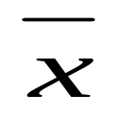

The CMOS NOT Gate
Contact Cut
Vp
Vp
X
n-well
X
X
X
Gnd
Gnd

Slide 18
Alternate Layout of NOT Gate
Vp
Vp
X
X
X
X
Gnd
Gnd

Slide 19
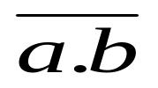


NAND2 Layout
Vp
Vp
X
X
X
Gnd
X
X
Gnd

Slide 20


NOR2 Layout
Vp
Vp
X
X
Gnd
X
X
X
Gnd

Slide 21
NAND2-NOR2 Comparison
Vp
X
X
X
X
X
Gnd
Vp
X
X
MOS Layout
Wiring
X
X
X
Gnd

Slide 22
NAND2-NOR2 Comparison
Vp
X
X
X
X
X
Gnd
Vp
X
X
MOS Layout
Wiring
X
X
X
Gnd

Slide 23
General Layout Geometry
Vp
Shared drain/
source
Individual
Transistors
Shared Gates
Gnd

Slide 24
Layout

Slide 25
Stick Diagrams
V_{DD}
V_{DD}
X
Stick
Diagram
X
X
X
Gnd
Gnd

Slide 26
Stick Diagrams
V_{DD}
V_{DD}
X
X
X
X
Gnd
Gnd

Slide 27
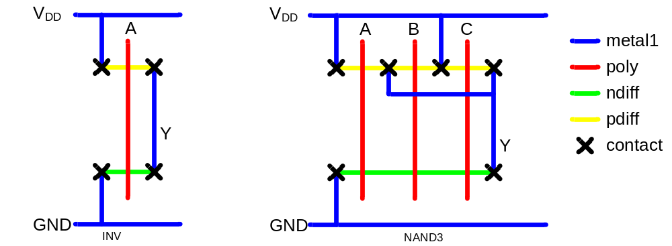
Stick Diagrams
Stick diagrams help plan layout quickly
  Need not be to scale
  Draw with color pencils or dry-erase markers

Slide 28
Stick Diagrams
VLSI design aims to translate circuit concepts onto silicon.
stick diagrams are a means of capturing topography and layer information using simple diagrams.
Stick diagrams convey layer information through colour codes (or monochrome encoding).
Acts as an interface between symbolic circuit and the actual layout.

Slide 29
Stick Diagrams
Does show all components/vias.
It shows relative placement of components.
Goes one step closer to the layout
Helps plan the layout and routing
A stick diagram is a cartoon of a layout.

Slide 30
Stick Diagrams
Does not show
  Exact placement of components
  Transistor sizes
  Wire lengths, wire widths, tub boundaries.
  Any other low level details such as parasitics..

Slide 31
Stick Diagrams
Metal
poly
ndiff
pdiff
Can also draw
in shades of
gray/line style.
Buried Contact
Contact Cut

Slide 32
Stick Diagrams – Some rules
Rule 1.
When two or more ‘sticks’ of the same type cross or touch each other that represents electrical contact.

Slide 33
Stick Diagrams – Some rules
Rule 2.
When two or more ‘sticks’ of different type cross or touch each other there is no electrical contact.
(If electrical contact is needed we have to show the connection explicitly).

Slide 34
Stick Diagrams – Some rules
Rule 3.
When a poly crosses diffusion it represents a transistor.
Note: If a contact is shown then it is not a transistor.

Slide 35
Stick Diagrams
Rule 4.
For depletion mode transistor put a yellow rectangle
Enhancement type Depletion type
Feature Symbol:

Slide 36
V_{DD}
Examples of NMOS Stick layout Design Style
V_{DD}
V_{DD}
8:1
V_{out}
V_{in}
1:1
GND
GND
NMOS Inverter
V_{DD}
V_{DD}
Bounding Box
8:1
Output
V_{out}
Input
1:1
V_{in}
GND
CK

Slide 37
Examples of NMOS Stick layout Design Style: Realizing a logic function X= A + BC
V_{DD}
V_{DD}
V_{out}
V_{out}
GND
V_{in}
Bounding Box
V_{DD}
V_{DD}
4:1
4:1
X
1:2
1:2
1:1
1:2
1:2
Bus
(B)
GND
GND
A
C

Slide 38
Stick Diagrams – Some rules
Rule 5.
In CMOS a demarcation line is drawn to avoid touching of p-diff with n-diff. All pMOS must lie on one side of the line and all nMOS will have to be on the other side.
Feature Symbol:
NMOS PMOS

Slide 39
How to draw Stick Diagrams
Stick Diagrams

Slide 40
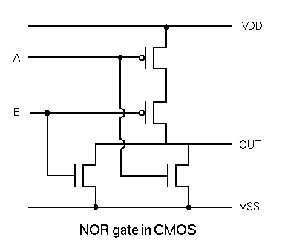
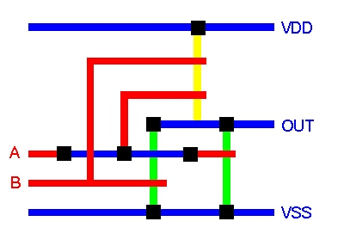
Stick Diagram – Example
A
OUT
B
NOR Gate

Slide 41
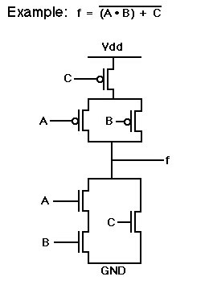
Stick Diagram - Example
Power
A
Out
C
B
Ground

Slide 42
Example: 1 bit shift register
V_{DD}
φ₁
φ₂
V_{DD}
V_{DD}
Demarcation line
Data input
Data output
φ₁
φ₂
V_{SS}
V_{SS}
V_{SS}
V_{DD}
V_{DD}
V_{SS}
V_{SS}

Slide 43
Example: 1 bit shift register
V_{DD}
φ₁
φ₂
V_{DD}
V_{DD}
Data input
Data output
φ₁
φ₂
V_{SS}
V_{SS}
V_{DD}
V_{SS}
Data input
Data output
φ₁
φ₁
φ₂
φ₂
V_{SS}

Slide 44
Stick Diagram to Symbolic Form: CMOS shift Register
V_{DD}
Data input
Data output
φ₁
φ₁
φ₂
φ₂
V_{SS}
V_{DD}
Data input
Data output
V_{SS}
φ₁
φ₁
φ₂
φ₂

Slide 45
Stick Diagram to Symbolic Form: CMOS shift Register
V_{DD}
Data input
Data output
V_{SS}
φ₁
φ₁
φ₂
φ₂
Can be merged
V_{DD}
Data input
Data output
c
d
a
b
V_{SS}
φ₁
φ₁
φ₂
φ₂

Slide 46
Points to Ponder
  be creative with layouts
  sketch designs first
  minimize junctions but avoid long poly runs
  have a floor plan plan for input, output, power
  and ground locations

Slide 47
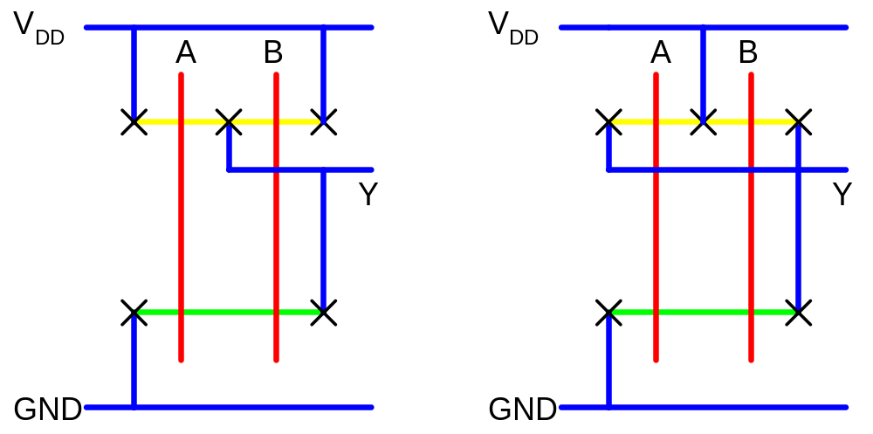
Layout Comparison
Which layout is better?

